Slide 1
Your Own,
Your Home, and Your Zone
A Primer on Self-Reliance and Sufficiency
Lt. Nick Alongi
Westchester County Police
naa5@westchestergov.com

Slide 2

Not to the extreme (hopefully)
Better to be safe, than….
Changing weather events
More demand on infrastructure and services

Slide 3
What is “self-reliance”?
Quite simply, the ability to survive on your own.
Hurricane/Super-Storm Sandy
  Emergency Services stressed
  Emergency supplies depleted (and non-emergency!)
  Utilities damaged
  Infrastructure damaged

Slide 4
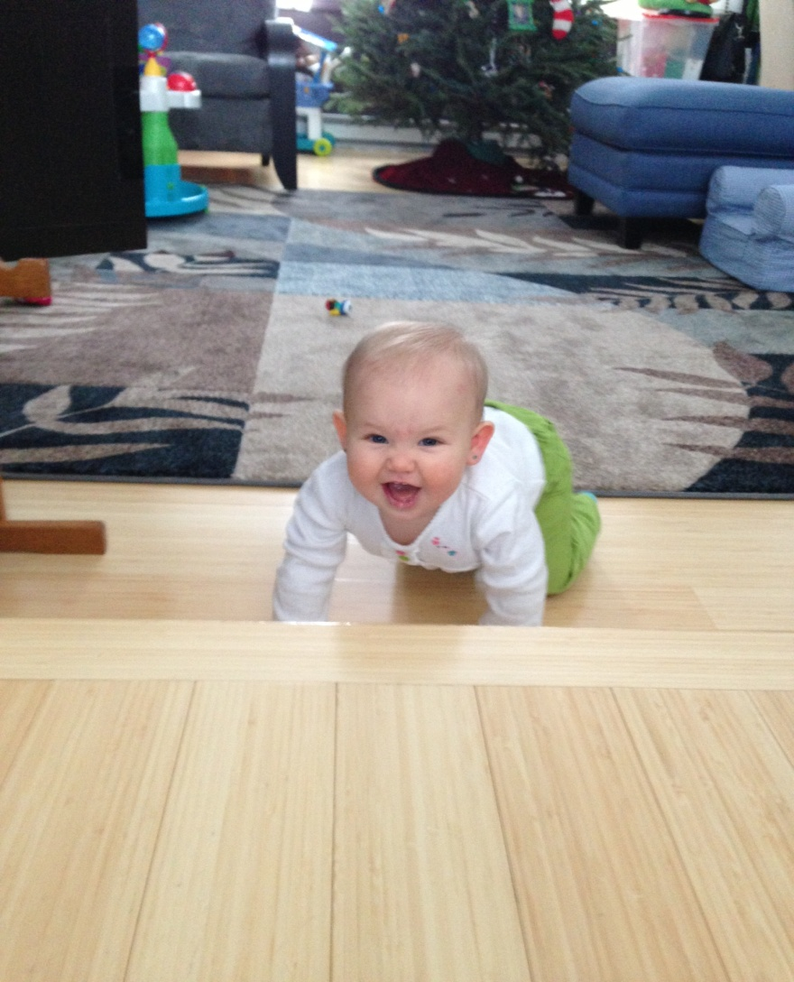
“Your Own”
Of course, the most important aspect.
“Strong foundation” for the mind.
Devil is in the details.
Easy to miss the little things.

Slide 5
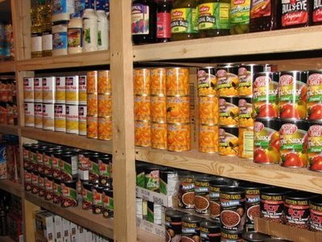
“Your Own”
Obvious Basic Human Needs:
Food (non-perishable, long-life)
Water (1 gallon per day per person)
Hygiene

Slide 6
“Your Own”
The not-so-obvious:
“Business as usual” for the kids
Entertainment (especially in our electronic society)
Medication (pre-emptive call to doctor for refill)
Spare glasses/contacts
Car chargers/converters
Copies of important paperwork (electronic too)
Cash
Go Bags

Slide 7
The “Go Bag”
A “Go Bag” is a kit that contains personal essentials to “grab and go” in case of an emergency.
Different kits for adults and children.
Family pictures, toys, comfort food, etc.
Vital info should also be included in kit.
Pre-made kits are sold online.

Slide 8
Common pitfalls….
Forgetting about YOU!
Arrangements at work
No plan
Know where everything is, and on that note…
keep your supplies and food accessible!!
Back-up to your back-up.

Slide 9
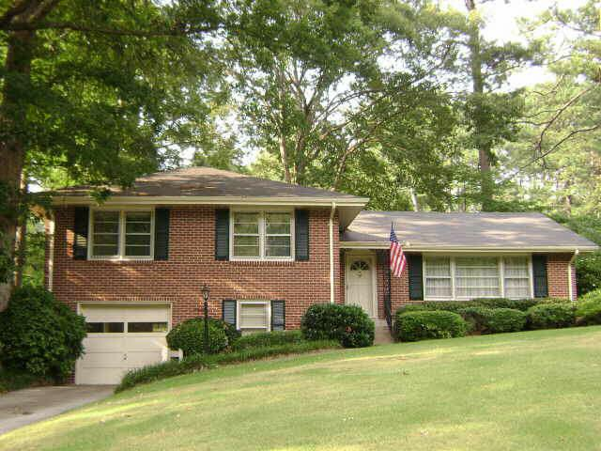
“Your Home”
Fill up on heating oil, propane, etc.
Board up sensitive structure points
Batteries, candles, flashlights, first aid
“Utility” water source (for well water users)
Prep small engine equipment!!
Take care of problems trees now!

Slide 10
“Your Home”
No heat? Let the water drip.
Gas powered equipment needs gas (stabilized gas is even better)!
Have an indoor rally point as well as an outdoor.
  BELOW-GRADE basements are good.
Turn your fridge and freezer way down (colder).
Fill car(s) up with gas to use as alternate source of power if necessary.

Slide 11
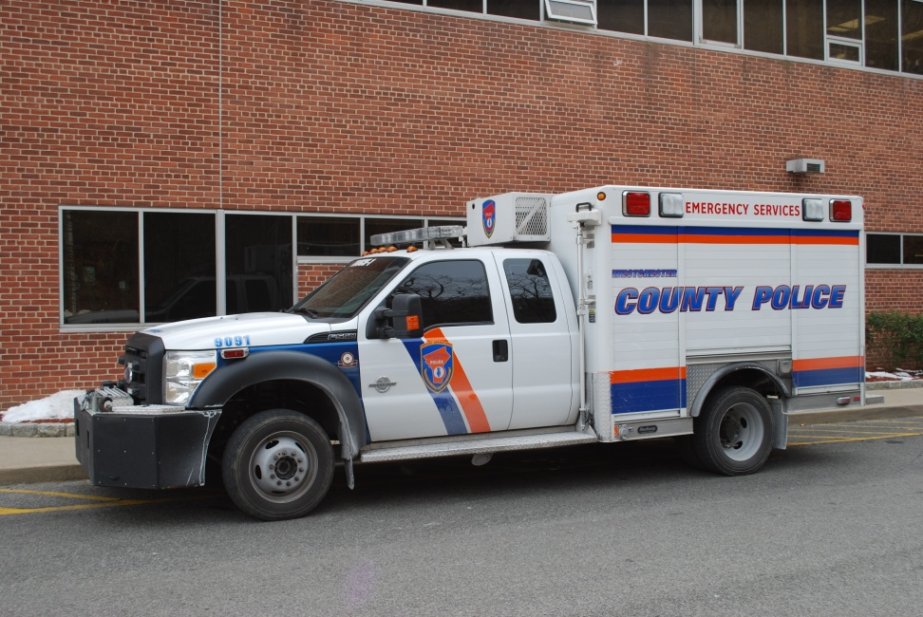
“Your Home”
Many injuries occur AFTER the event!
  Generators
  Gas/wood stoves
  Electrical
  Chainsaws
You’re no good to you or anyone else (especially during a crisis) if you’re injured!

Slide 12
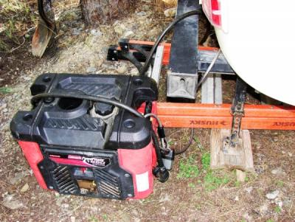
Generator security….
Targets for theft
Protect yourself…
Sound cues
Lock it up
Diesel is quieter
Whole house model

Slide 13
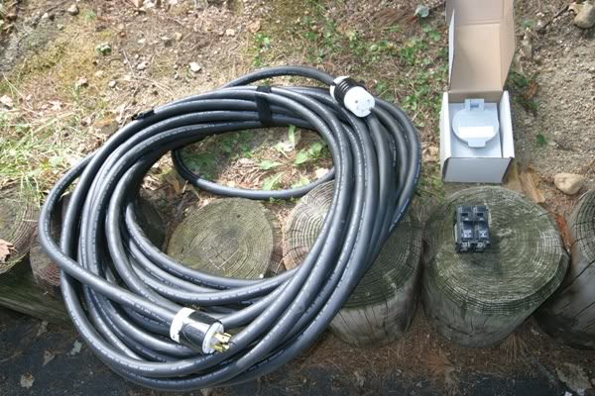
Generators and Heaters
Generators are a great tool to make you self-sufficient.
  DO NOT RUN YOUR GENERATOR IN A GARAGE OR BASEMENT…EVER!
  DO NOT COVER SPACE OR PROPANE HEATERS WITH TARPS OR BLANKETS WHILE RUNNING!
  HAVE YOUR GENERATOR WIRED TO YOUR HOUSE BY A QUALIFIED, LICENSED ELECTRICIAN!

Slide 14
Many moving parts….
Your home has many systems and parts…
Teach your wife/husband/S.O.
…and kids!
Accurate labeling
Accurate information
Does it work!?

Slide 15
Don’t assume anything!
Dead wires don’t stay dead.
Dry ice isn’t a guarantee…
…nor is food reimbursement.
ID utility workers that want access to your home!

Slide 16
“Your Zone”
Not everyone can take care of themselves.
The concept of “neighborhood reliance” pools a community’s resources to achieve self-reliance on a larger scale.
Can be several houses or a whole condo development.

Slide 17
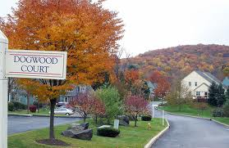
“Your Zone”
Community food bank
Neighborhood watch
Carpooling
Share resources
Take turns checking on elderly

Slide 18
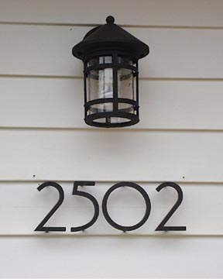
Help us help you…
Have your house number visible (mutual aid)
Check on (and call for) neighbors
Traffic light out = STOP SIGN!
Annoy ConEd

Slide 19
General Preparedness Resources
Disaster Prep Checklists
  http://www.fema.gov/pdf/areyouready/appendix_b.pdf
  http://www.ready.gov/basic-disaster-supplies-kit
  https://www.critikit.com/?gclid=CNXPze_tg7UCFQ-e4AodOVgAew
  www.72hours.org (San Diego DEM)
TONS of info out there since Sandy…
Still don’t hesitate to call your first responders!
Think like the Navy Seals!
  “Two is one and one is none!”

